Slide 1
NV Commission on Innovation and Excellence in Education
From Roadmap to Roadwork
February 26-27, 2026
Notes:
SLIDE 1-11 NATHAN

Slide 2
IV
Welcome and Review of Process, Goals, and Agenda
Notes:
10:20-10:45 am
Commissioners will review the Commission’s process, confirm meeting goals, revisit the arc of learning for 2025–26, and walk through the agenda for this meeting.
Joyce Woodhouse, CIEE Chair
Patty Charlton, CIEE Vice Chair
Dr. Victor Wakefield, State Superintendent of Public Instruction
Nathan Driskell, Chief Policy Officer, NCEE
Janice Case, Regional Director, West, NCEE

Slide 3

Framing the Day
Day 1 Agenda and Goals
Wifi: 0448-wifi
PW: 4swct@48
10:00–10:45 | Grounding + Context Goal: Align on where we’ve come from, what’s changed since the Roadmap (funding, leadership, legislation), and what we need from this two‑day meeting.
10:45–12:00 | Shared learning: What does “roadwork” mean? Goal: Get on the same page about how the Commission creates real impact without big new dollars—and what “success” looks like this year.
12:45–3:45 | Subcommittee Breakouts → Share-Back Goal: Apply the shared language to each subcommittee’s “offer” and sharpen near-term actions, owners, and evidence we can point to by June/December.

Slide 4
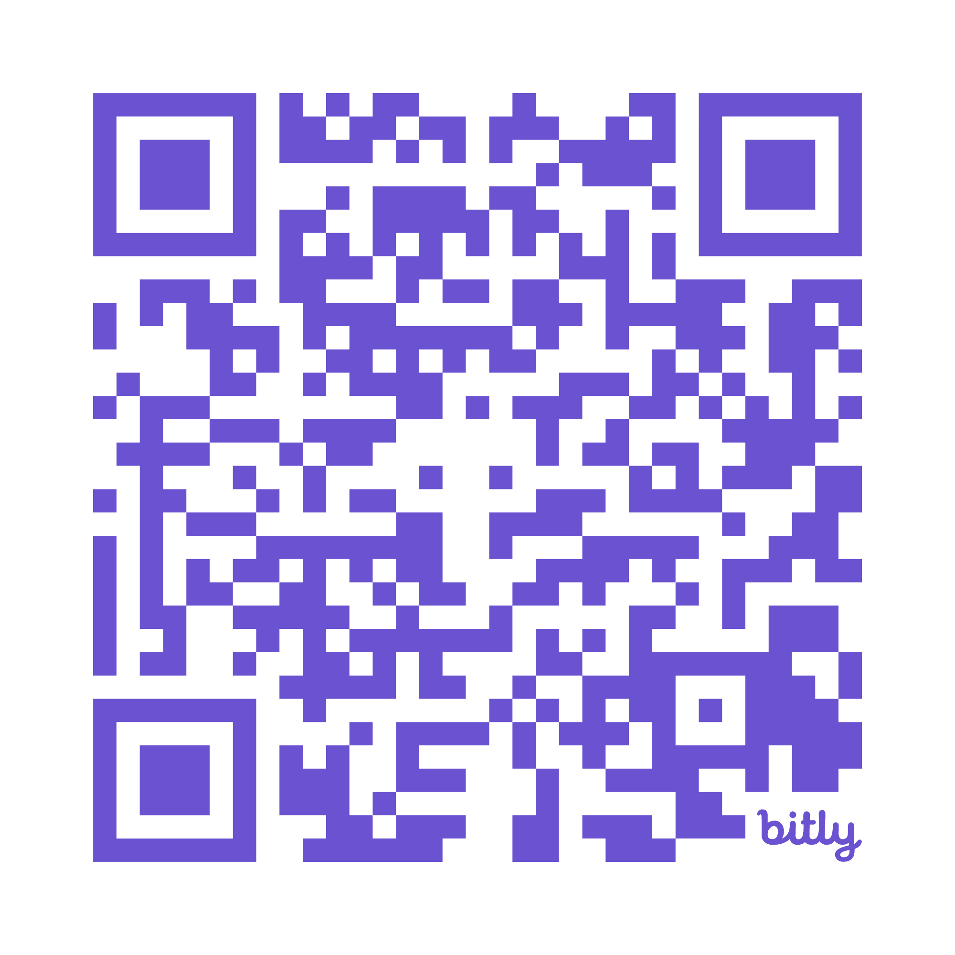
Today’s Materials
Slide Deck
Informational Briefs
Note-Takers
DISCOVER
https://bit.ly/CIEEDay1
WIFI: 0448wifi PW: 4swct@48

Slide 5
The Nevada Commission on Innovation and Excellence in Education
This Commission was created by SB 425 (2023) to establish the policy framework for a world-class, globally competitive, and adaptable education system that supports every child. This means ensuring every learner in Nevada develops the knowledge, skills, and dispositions needed to thrive in an increasingly challenging and uncertain future.
Commissioners represent:
Educators
Policymakers
Communities
Commissioners have sought to engage more voices in conversations wherever possible by:
Inviting perspectives from youth, educators, and higher education.
Holding our Commission meetings in schools.
Conducting visits to rural schools and hearing from youth and educators.

Slide 6
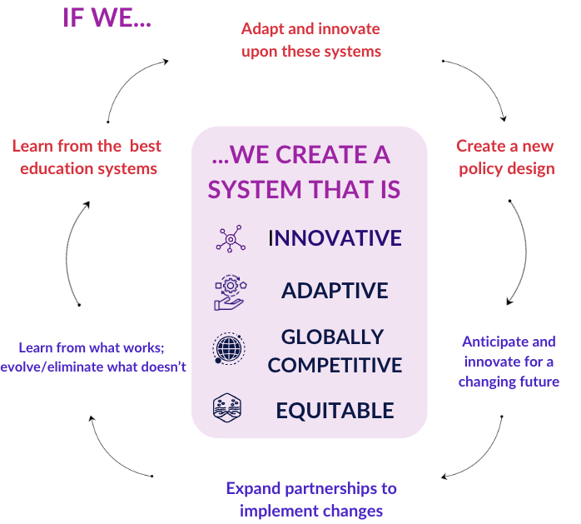
Commission Change Process

Slide 7




The Roadmap
2030 End Goal
A world class education system for Nevada Learners.
2028 Interim Goals and Action Steps
Intentional progress monitoring with opportunities to learn, adapt, and course-correct along the way.
2026 Policy Infrastructure to Launch Nevada
Goals, legislation, enabling conditions, and metrics to ensure progress towards 2030 End Goal
2024 - 2025
Preliminary Roadmap and Recommendations

Slide 8
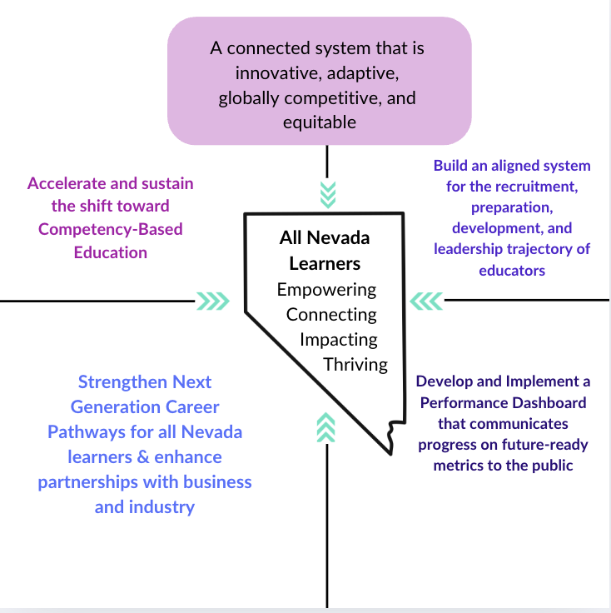
Commission Recommendations

Slide 9
Since the Roadmap was published…
SB403 is introduced to support implementation of the roadmap’s recommendations. Ultimately does not pass.
SB460 amends the responsibilities of the commission and mandates redesign of numerous accountability structures for Nevada schools.
SB4 appropriates $1.95M to implement the recommendations in the roadmap.

Slide 10
2025-2026 Cycle Objectives
The Commission’s primary objectives this cycle are:
Make “YES” the easy path statewide.
Offer tools, clarity, permissions, and supports
Incentivize action and reduce barriers
Keep the Roadmap live.
Expand visibility and collective ownership
Make updates and refinements
Prepare targeted guidance and recommendations.
Name additional policy/administrative enablers based on what emerges from subcommittee work.
Notes:
The Commission’s first job this year is to make it easy for Nevada’s operators and partners to say yes to the Roadmap. We earn uptake amongst core operators by offering tools, clarity, permissions, and supports that make Roadmap adoption feasible and desirable.
Keeping the roadmap live means taking the Roadmap on the road and increasing familiarity with key stakeholders. It also means engaging in update cycles with clear roles and decision rules.
Finally, we’ll define a short list of additional policy/administrative recommendations based on subcommittee work that we know will enable and accelerate progress toward the vision outlined in the roadmap.

Slide 11
Our Progress this Cycle
In the past six months, the Commission:
Increased visibility of and spread awareness of the roadmap.
Nevada Association of School Superintendents
Subcommittee for Accountability Redesign
Commission on School Funding
Nevada Association of School Administrators
Nevada Future of Learning Network
Broadened its coalition to include additional critical stakeholders.
Identified a short list of priority areas to enable uptake and ownership of the roadmap.
Subcommittee Offers
Began planning the use of funding appropriated via SB4 Sec 5.1 to implement the recommendations outlined in the roadmap.
Clarifying allowable use and disbursement logistics.
Generated initial criteria for the establishment of a working group
Took steps toward clarifying and executing on new responsibilities outlined in SB460 Section 5.5.
Collaboration with NDE on data requirements
Consultation with Fiscal Counsel

Slide 12
V
What Does ‘Roadwork’ Really Mean?
A Shared Language for Moving from Ideas to System Change
Notes:
SLIDES 12-31 JANICE
10:45am-12:00pm
Shared Learning and Discussion: What does “Roadwork” really mean? (10:45am-12:00pm)
Commission members will participate in a shared learning session to clarify what “roadwork” means in practice—how the Commission’s Roadmap translates into concrete implementation actions, roles, and timelines. The Commission will discuss implications for near-term work and consider possible actions to advance implementation.
NCEE Staff and Commission Leadership

Slide 13
Item V: Outcomes (75 Min)
Refine our “operating stance” for impact in this phase of the commission’s work.
Brainstorms risks and guardrails to successful “roadwork”.
Begin defining evidence-based “accomplishment” by June 30 + December 30

Slide 14

Surfacing Collective Wisdom:
Impact regardless of funding.
Two Rounds of Paired Conversation
4 minutes each + 1 minute switch
Think of a time you saw a commission/cross‑sector coalition create real impact without big new funding. What did they do that actually moved the system (not just produced a report)?
Each person write 1 sticky:
“The move was _____. It worked because _____.”

Slide 15

Framing Our Role
Commissioners are curators of innovation: surfacing district bright spots, ensuring coherence, and giving feedback that balances statutory requirements with future-forward vision.
Commissioners are coordinators and enablers of the groups who do the technical work: they are a group wherein ideas are stress-tested and aligned, and where stakeholder voices are elevated.

Slide 16
What does this mean in practice?
“
Directions
Select the option that resonates with you most.
Silent edit
(3 min)
Table Synthesis
(6 min)
Whole Group
(3 min)
Option A
“In 2026, the Commission’s job is to move the Roadmap from paper to practice by making it easier for implementers to act. We will clarify expectations, remove barriers, connect decision-makers, and make targeted recommendations—then track whether it’s being used.”
Option B
“In 2026, we will focus on a short set of high-leverage Roadmap priorities and deliver concrete, usable outputs, so we can point to real near-term progress even without major new funding.”

Slide 17
A Shared Language for Action:
Moving from Ideas to System Change
Across subcommittees, we are clarifying enabling conditions and surfacing system barriers and constraints. Many of those barriers and constraints are:
Outside the Commission’s direct authority
Long‑term and not fixable in a single cycle
Dependent on other owners (agencies, districts, institutions, employers, Legislature) to move
If we don’t share a common way to prioritize and plan action, we risk:
Over‑promising on what the Commission can “do”
Under‑utilizing the Commission’s real power (convening, coherence, permissioning, and handoffs)
Producing good artifacts that don’t get adopted (no owner, no carrier, no permissions)

Slide 18
Discussion:
Risks
and Guardrails
Which risk is most likely to be an issue for the commission this year?
Over‑promising what we can “do”
Under‑using convening/permissioning/handoffs
Producing artifacts that don’t get adopted
What other risks do you foresee as the Commission and Roadmap mature?
What would that risk look like in real life, and what’s one guardrail to prevent it?

Slide 19
Shared Lenses for Action:
Moving from Ideas to System Change
Commission Role | Do, Enable, Recommend, Monitor
Do and Enable | Non-Legislative Toolbox: 6Cs (Clarify, Connect, Convene, Codify, Catalyze, Communicate)
 | Sequencening: Proof → Permission → Handoff
Ownership | Carrier, hosts, and maintainers of the work
 | Three Tiers of Operators
Recommend | Legislative and Administrative Policy Toolbox
Timeline | Now, Next, Later

Slide 20
JIGSAW DISCUSSION
Directions
Each table owns 1-2 lenses
Answer:
In plain language, what does this lens help us do better as a commission?
How does it help us have impact without major new money/authority?
What’s the risk/failure mode it helps us avoid?
Prep a 90‑second teach-back
Table Assignments
Table 1: Do, Enable, Recommend, Monitor
Table 2: 6Cs non‑legislative toolkit
Table 3: Proof → Permission → Handoff + Timeline
Table 4: Operators + Owner Map
Table 5: Policy levers: 5Ps

Slide 21
The Commission’s Role:
Do, Enable, Recommend, Monitor
These are direct Commission outputs and Roadwork levers that can be pulled. They are the things the Commission (and its partners like NCEE) can produce or run.
DO
Enable others to act by reducing friction and increasing “permission to proceed.” This is the heart of making “YES” the easy path: tools, clarity, permissions, supports. Enabling typically shows up as convening, brokering, clarifying, coordinating, and legitimizing.
ENABLE
Track whether uptake is happening and whether owners are maintaining the work; keep the Roadmap live with update cycles and decision rules. This includes “learning loops” like hearings, operator feedback, and revising artifacts as reality changes.
MONITOR
Put forward formal recommendations (e.g. policy, regulation, funding, and governance) especially when authority, significant financial investment, or statewide alignment is required.
RECOMMEND

Slide 22
Do and Enable: Non-Legislative Toolkit
CLARIFY | Shared definitions, plain-language guidance, what’s “in” vs “out,” what’s allowed.
CONNECT | Broker relationships and points of contact; reduce “who do I call?” friction.
CONVENE | Bring the right owners into the room with a specific decision to make.
CODIFY (NON-STATUTORY) | Create model MOUs, templates, playbooks, checklists—standard work that reduces variance.
CATALYZE | Seed pilots, prototype artifacts, recruit early adopters, gather proof.
COMMUNICATE | Storytelling, operator wins, bright-spot evidence, and “how to plug in” messaging.
Notes:
Many high-leverage moves won’t be legislative; they’ll be “permission structures” and coordination fixes. The 6Cs are the Commission’s non-legislative “toolkit” for executing the functions outlined above and are mechanisms to convert ideas into adoption. These “Enable” and “Do” moves help others act—often faster than legislation. They can be applied to any topic.

Slide 23





Non-Legislative Toolkit: Sequencing
Proof, involves answering the question “How do we know this will work here?” Proof often involves highlighting (a) Bright spots and credible examples and (b) evidence that addresses skeptic questions (e.g. outcomes, cost, feasibility, staffing, supervision, compliance).
Permission, involves answering the question “How do we know this is safe to try?” These actions reduce perceived risk and can include things like templates, guidance, clarity, and endorsements.
Handoff, involves answering the question “Who owns this after we leave the room?” Successful handoffs clarify who the named hosts and maintainers are and what changes hands (host, maintain, train, fund).
Notes:
Sequencing action for coordination is a key way to ensure that the right levers are pulled at the right time. Commonly, this looks like orchestrating cycles of Proof → Permission → Handoff:

Slide 24
Operators
Three Types of “Operators” in Nevada’s Education Ecosystem
 | Examples | What they “operate”
Frontline Implementers | Teachers, counselors, principals, CTE coordinators, work-based learning site coordinators, postsecondary faculty, employer mentors | Classrooms, counseling programs, work-based learning sites, dual-credit courses
System Intermediaries | District C&I leaders, RPDPs, charter networks, regional workforce boards, industry intermediaries, chambers | Professional development, technical assistance, cross-sector coordination
Administrative Enablers | NDE program staff, NSHE academic affairs, GOED/DETR staff, local superintendents | Funding rules, accountability processes, policy guidance, data systems

Slide 25
Owner Map
An owner map answers five concrete questions:
01
Who is the primary owner?
Who hosts/ maintains this after the Commission’s push?
02
Who are the co-owners?
Who will implement, disseminate, fund, or regulate?
03
Who are the carriers?
What are the channels that make it travel–RPDPs, associations, intermediaries, chambers?
04
What routine will it live in?
e.g., which PD cycle, contract cycle, scheduling cycle, accountability/ reporting cycle?
05
What is the minimum viable maintenance plan?
e.g., update cadence, steward, feedback loop?
Notes:
Success requires moving beyond a simple list of those who should be involved in planning and action, and toward clear articulation of how co‑owners interact.
Mapping owners across the three operator tiers can be helpful in ensuring that all levels of implementation are taken into account.

Slide 26
Policy Levers: The 5Ps
Prohibit
Ban or restrict a practice (rarely the first move; use when harm is clear).
Permit
Create legal authority / remove a barrier (authorize, clarify, allow flexibility).
Prescribe
Require a practice or standard (mandate; define minimums; set guardrails).
Promote
Incentivize, encourage, prioritize, recognize, fund, socialize, or provide technical assistance with the aim of accelerating adoption.
Promise
Commit resources or provide guarantees (appropriation, protected funding stream, entitlement).
Notes:
When something does require policy movement (be it legislative or administrative), a shared taxonomy is helpful so recommendations are comparable across subcommittees.
This helps the Commission avoid “recommendation soup.” It also helps surface trade‑offs: Prescribe without Promise can create unfunded mandates; Promote without Permission can create voluntary uptake failure. If we can’t clearly name which P we’re pulling, we may not be making a policy recommendation yet—we might still be in need of Proof or Permission.

Slide 27
Timeline
Now: 0-90 Days
Next: Through June 30, 2026
Later: Next Cycle and Beyond
Definition: Work we can begin immediately with existing authority and minimal dependencies. Typical outputs: drafts, maps, proof points, a strawman, a working group charter, a model template, a short list of “owners,” or a first-pass inventory. What these outputs are intended to accomplish: Clarify, pressure‑test, and simplify. Gather proof from the field; identify minimum permissions. Identify candidate owners/carriers and what it would take for them to accept a handoff. | Definition: Work that needs coordination, refinement, and real-world stress-testing before June deliverables and the annual report. Typical outputs: refined tools, formalized guidance, an agreed owner/carrier plan, recs ready for inclusion in the June 30 report, and “permission” artifacts that reduce risk for operators. What these outputs are intended to accomplish: Secure legitimacy: endorsements, formal adoption, agency alignment, and “permission stack.” Draft policy/administrative recs that are realistic for the June 30 milestone. Confirm handoffs: who hosts, maintains, trains, funds. | Definition: Structural shifts, funding changes, statutory changes requiring long lead time, or system rebuilds. Typical outputs: multi-year implementation plans, rulemaking, sustained funding, institutionalization into agency routines, and scaled adoption pathways. Key discipline: “Later” does not mean “ignore.” It means “design the on-ramp now, don’t over-promise delivery now.” What these outputs are intended to accomplish: Implementation and diffusion- embed in routines, update cycles, training pathways, monitoring. Legislative or other policy change and systemic resourcing

Slide 28

Practice: Roadmap to Roadwork
NGCP
WCTL
MWM
NGCP will collaborate with relevant stakeholders to curate and socialize resources that expand employer-district partnerships and strengthen youth career exploration opportunities.
The WCTL subcommittee will collaborate with stakeholders to make decisions about use of the appropriation granted under SB4 for roadmap aligned professional development. Funds must be used by June 2027.
The MWM subcommittee will collaborate with the CSF and NDE to Establish a centralized repository of all reports of data relating to pupil achievement and financial accountability and make the centralized repository easily accessible on the Internet website of the Department.
Read your selected priority.
Reflect on what the “roadwork” might look like.
Process/justify using at least two lenses (e.g. Owner Map + Timeline)

Slide 29
Success Markers
What Will
Count as Accomplishment?
By June 30, we can say we accomplished ____.
By Dec 30, we can say we accomplished _____.
We’ll know because we can point to evidence:
an adopted artifact/tool,
a named owner + carriers, and
a feedback/maintenance routine.
Silent write (2 min) → Pair Share (2 min) → Whole Group Harvest (2 min)

Slide 30
Closing:
What We’re
Carrying into Breakouts
Clarity about:
Our operating stance
Our guardrails (top risks + prevention)
Our success markers
The 3 questions we’ll keep asking to stay on track:
What are we trying to make a ‘YES’ for operators?
Who owns it after we leave the room and what routine will it live in?
What proof/permission/handoff is required so it gets adopted?

Slide 31
VI
Lunch Break
Notes:
12:00pm-12:45pm

Slide 32
VII
Subcommittee Breakouts
Notes:
SLIDES 32-37 NATHAN
12:45-3:00 pm

Slide 33
2025-2026 SUBCOMMITTEES
Measuring What Matters | Next Generation Career Pathways | World-Class Teaching and Learning
Adam Young Tim Hughes Angela Taylor Sean Parker Sebastian Rios Patricia Charlton Selena Torres-Fossett Peter Zierhut Rebecca Garcia Steve Canavero | Lindsay Diamond Carrie Buck Joyce Woodhouse Matthew McNair Maite Salazar Mariluz Garcia Teresa Dastrup Aaron Frantz Peter Zierhut | Kenny Varner Malinda Riemersma Sandra Kupfer Victor Wakefield Marilyn Dondero-Loop Bernnell Peltier-Glaze Nicole Rourke Anthony Nunez Tanya Flanagan Dr. Gregory Koenig Laura Jeanne Penrod Rebecca Garcia
Notes:
This is not a report-out. It’s a system alignment lab. Each subcommittee has done real roadwork. Our goal this hour is to make visible:
Where the work reinforces each other,
Where coordination is required,
And what decisions each group is moving toward.
We are not debating SB4 allocations or reopening accountability redesign today.
We are clarifying architecture and sequencing.

Slide 34
The Promise
Every Nevada learner will benefit from a fair, future-ready accountability system that measures real learning and growth—so progress is clear, gaps are visible, and improvement happens faster in every school.
Measuring What Matters
Roadmap
&
Portrait
Every Nevada learner—wherever they live—can explore careers early and often, gain real work experience, and graduate with real options: college, training, or a good job they’re ready for.
Every Nevada learner will learn in engaging, challenging, and personalized environments— moving forward when ready, showing what they know in meaningful ways, and graduating prepared for the futures they choose.
Next Generation Career Pathways
World-Class Teaching and Learning

Slide 35

The Offer: Our Roadwork in 2025-2026
Next Generation Career Pathways
World-Class Teaching and Learning
Measuring
What Matters
Coordinate and Fund Quality Professional Learning Providers
Coordinate and Fund Principal-Focused PCBL Development
Launch Higher Ed-District PCBL Preparation, Practicum, and Induction Pilots
Coordinate with Dept of Ed and CSF to execute new responsibilities outlined in SB460 Section 5.5.
Ensure that School and District performance frameworks developed by SAR are enabling of the roadmap’s recommendations and reflect learner-centered, future-ready design principles.
Enable Expanded Advising Capacity
Explore Opportunities to Reduce Employer Friction
Identify and Promote Operator Wins

Slide 36















Standing Invited Guests

Slide 37


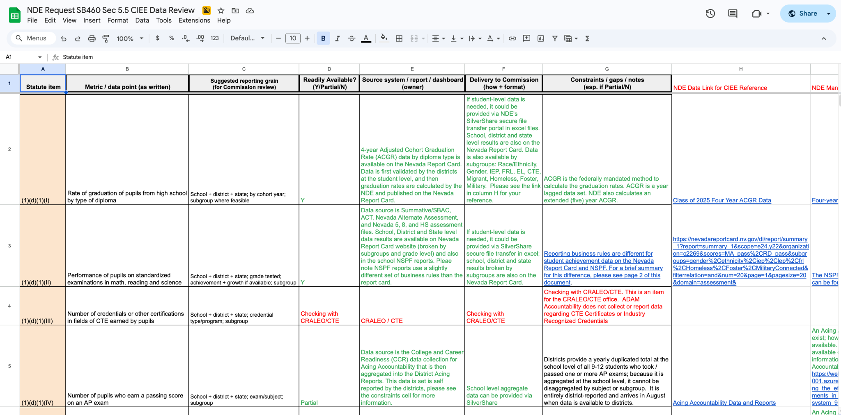
Today’s Deep Dives
https://bit.ly/CIEEDay1
SB460 Sec 5.5
+
NDE Data Request Response

Slide 38
VIII
Plenary Shareback
Notes:
SLIDE 38 JANICE
3:00-3:45 pm

Slide 39
IX
Synthesis and Next Steps
Notes:
SLIDES 39-40 NATHAN
3:45-3:55 pm

Slide 40

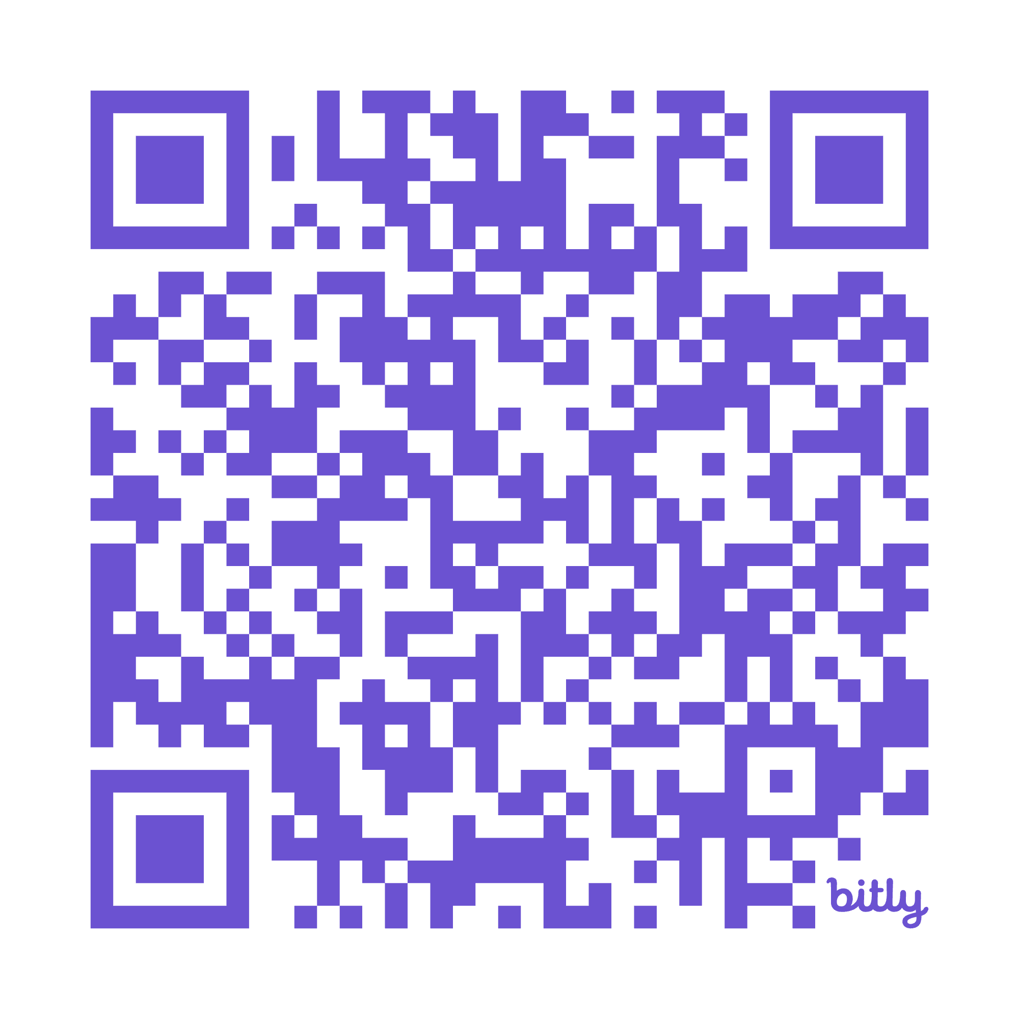
Looking ahead to tomorrow…
https://bit.ly/CIEEDay1Reflection

Slide 41
NV Commission on Innovation and Excellence in Education
From Roadmap to Roadwork
Day Two
27 February 2026
Notes:
SLIDES 41-47 JANICE
8:00am

Slide 42
III
Review of Process, Goals, and Agenda
Notes:
8:15-8:30 am

Slide 43
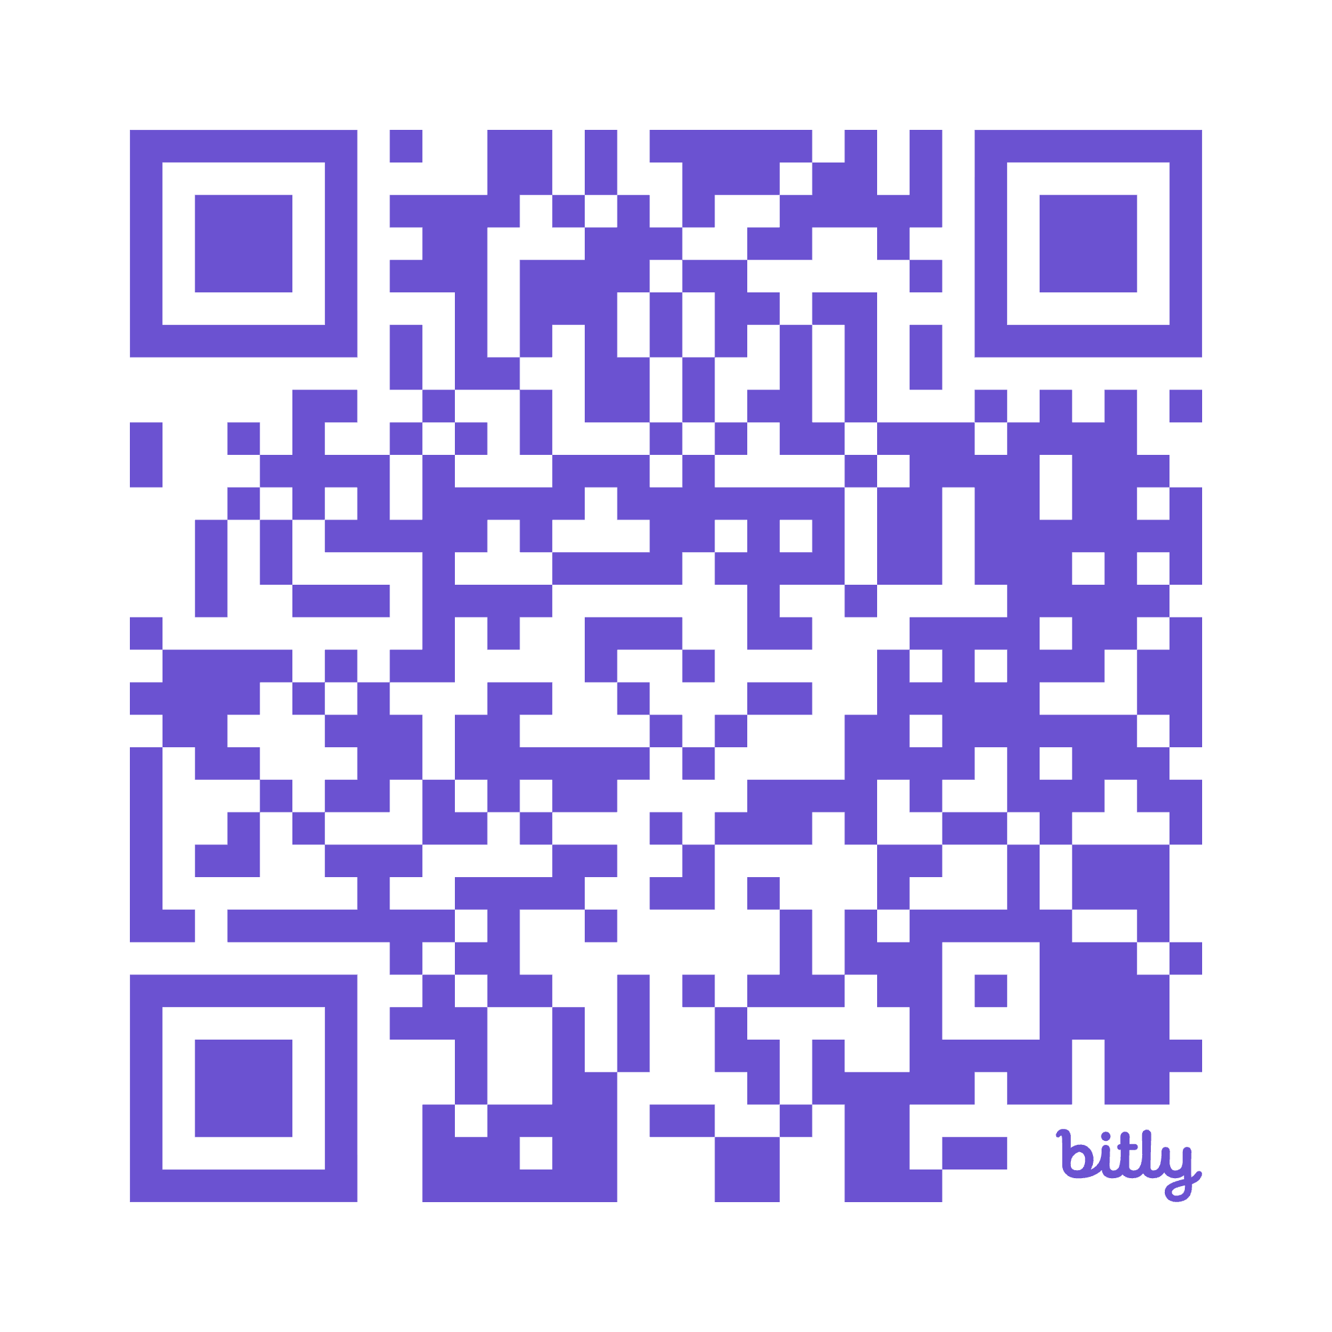
Today’s Materials
Slide Deck
Informational Briefs
Note-Takers
DISCOVER
https://bit.ly/CIEEDay2
WIFI: 0448wifi PW: 4swct@48

Slide 44


Summary of Themes and Reflections from Yesterday’s Meeting: Question 1
Role clarity is landing
Clearer understanding of our role as curators/enablers (not implementers).
Stronger grasp of “roadmap → roadwork.”
Better alignment on balancing innovation and statutory requirements.
SB460 clarity was meaningful
Shared understanding of what the bill requires.
Clarity on metrics vs. what we already measure.
Recognition that the legislation creates opportunity for study and refinement.
Framework + structure supported thinking
Breakouts enabled deeper conversation.
Guided questions helped sharpen discussion.
Materials and pre-work were useful anchors.
Notes:
Question 1 Posed: What Felt Most Important / Clarifying / Sticky About Where We Are
Find a partner in the room today - preferably someone you didn’t spend time chatting w/yesterday - and review/reflect.
Note:
What’s encouraging is that role clarity is landing. Many of you named a clearer understanding of our role — especially the shift from implementers to curators and enablers. And the SB460 breakdown seems to have been a real clarity moment.”
That’s foundational. Without that, today’s work would be murky.

Slide 45
Summary of Themes and Reflections from Yesterday’s Meeting: Question 2
Sharpening tangible outcomes
Clearer definition of what we will accomplish by Summer 2026.
Concrete data points subcommittees will use to make recommendations.
Mapping players/owners more concretely.
Balancing innovation + compliance
Staying future-focused while navigating accountability.
Tensions around internships / under-18 participation.
Allowability questions in PCBL and accountability work.
Direction + communication
More clarity for schools/districts about what we are doing.
How teachers are included in this work.
How subcommittees connect to each other’s metrics.
Notes:
Question 2 Posed: What You Want to Resurface / Revisit / Go Deeper On Today
Find a partner in the room today - preferably someone you didn’t spend time chatting w/yesterday - and review/reflect.
What you’re asking for today is not slower pace — it’s sharper outcomes.
You want clearer deliverables, clearer data points, clearer sequencing between now and Summer 2026.
This is a signal that we’re ready to move from alignment into disciplined prioritization.
And question 3: What We Should Keep Doing (Kudos)
Breakout structure and guided questions.
Cross-sector collaboration and voice.
Strong prework and materials.
Data grounding and bill walkthrough.
Overall pacing and productivity.
Inclusion of NDE and stakeholder voices.
Minor adjustments noted:
Improve tech/audio for remote participants.
Explore efficiency with time (working lunch).
Continue referencing the Roadmap explicitly.
What I notice across all three questions is momentum. There’s clarity, urgency, and appetite for specificity.”
“That’s a healthy place for a commission to be on the morning of Day 2.

Slide 46
Framing the Day
Agenda and Goals
Wifi: 0448-wifi
PW: 4swct@48
8:00–8:30 | Open + re-orient Goal: Close the loop from Day 1 and review the goals and agenda for Day 2
8:30–11:45 | Subcommittee work → plenary share-back Goal: Sharpen each subcommittee’s near-term actions and surface cross-cutting dependencies for full-Commission alignment.
12:30–2:00 | Full Commission: SB460 Section 5.5 + next steps Goal: Agree on how we’ll meet the new requirements—shared stewardship across subcommittees with NDE, a draft workflow, named owners, and key open questions.

Slide 47
IV
Subcommittee Breakouts
Notes:
8:30-10:45 am

Slide 48


Today’s Deep Dives
https://bit.ly/CIEEDay2
NGCP
WCTL
MWM
SB460 Sec 5.5
+
NDE Data Request Response
Notes:
We’ll convene back in our same spaces. We’ll ask that one person per table be on hand again to access zoom if we have someone online.

Slide 49
V
Plenary Shareback
Notes:
SLIDES 48-49 JANICE
10:45-11:45 am

Slide 50
System Alignment Lab Prep: 3-32
3 Insights
3 Near-term moves between now and June
2 Dependencies (or asks)
Notes:
(10 min prep; 15 minute total for WG share out)
Step One - Each subcommittee has 5 minutes to share their responses to the above.
Pick 2 “presenters” to share the responsibility

Slide 51
Measuring What Matters
Insights on SB 460
SB 460 requires us to review 26 additional metrics; of these, 16 are readily available in data dashboards or we have a proxy we feel is appropriate
For another 10 metrics, we need to do additional work to align on a valid proxy or figure out a next step
Our role in recommending metrics that are redundant or ineffective builds on existing work from the CSF and the ESC
Our role in “establishing a centralized data repository” involves collaborating with existing work underway at NDE
Immediate Next Steps
Organize visual to review existing metrics
Align on reliable proxies for remaining metrics (e.g., parent satisfaction) (may require Commission input)
Revisit research on high performing systems to decide on new metrics we may need (in the long-term future)
Elaborate on a preliminary recommendation for supply side reporting
In April, review forthcoming report from ESC on redundant metrics; offer additional recommendations and revisions
By June, connect with Supt, NDE data and technology experts to review progress on centralized repository, offer suggestions and feedback.
Interdependencies: Will will facilitate a session this afternoon on this topic. We know we need: guidance from NGCP on systems-level outcomes for readiness and access; discussion and affirmation on future-ready metrics we are exploring piloting; greater clarity on state-level vs classroom level measures /pilots.
Notes:
We’re treating that as a requirement to deliver a June 30 report with: (1) redundancy recommendations, (2) a coherent reporting framework that complements SAR, and (3) pilot-ready options for next-generation measures—without prematurely locking Nevada into metrics that aren’t validated or implementable statewide.

Slide 52
Cross Subcommittee Triad Lab
Where do our roadwork moves reinforce each other?
Where does one group depend on another?
What must be coordinated in the next 90 days?
Notes:
25 minute discussion
Form Triads - start w/NGCP (smallest group); then add WCTL and MWM to each over and over until groups formed
Discuss the prompts here in preparation for a whole group discussion
Then Back to whole Group:
What are we noticing about alignment?
*Capture notes under these headings:
Reinforcement
Dependencies
Coordination Needed (Next 90 Days)
Finally - ask each subcommittee lead to articulate a response to this prompt:
Between now and the next full Commission meeting, what decision are you working toward?
Closing:
What I’m hearing is not three workstreams — but one system moving in coordination.
If we stay disciplined about ownership and coordination, we avoid siloed roadwork.

Slide 53
VI
Lunch Break
Notes:
11:45 am - 12:30 pm

Slide 54
VII
Discussion SB460 Section 5.5
Notes:
SLIDES 50-57 NATHAN
12:30 pm - 1:30 pm

Slide 55
The Work of 2024
Throughout 2024-2025 the Commissioners:
Researched global best practices and the local Nevada context
Produced a document that articulated:
Shared 10-year vision across multiple time horizons
Change process
Policy principles for realizing that change
Concrete policy recommendations
Gathered feedback on the document from their constituencies
Translated many of those recommendations into a single bill (SB 403) (which did not pass)
Created a shared roadmap that lays out a five-year course of action to 2030 and names the respective responsibilities for collaboration among relevant agencies (SBE, NDE, WBD, NASS, etc.)
Observed specific recommendations embedded in different ways in other bills garner support via passage: SB 460, AB 539, and SB 571.
Notes:
Joyce to end here.

Slide 56
What We Studied
Global Research & Best Practices: from OECD, World Bank, Singapore, Finland, Estonia, Ontario, Massachusetts, Maryland, Mississippi, Utah, etc.
Global Perspective on what “Best” in education can be
People: National Center for Education & the Economy (with insight from America Succeeds, KnowledgeWorks, Carnegie, & more)
How do we get there (Our Roadmap): 1. World Class Teaching & Learning (PCBL)
2. Next gen career pathways
3. Measuring what matters in an evolving world
Local Research & Best Practices: NV Portrait work, input from all 18 NV Districts and business/community/parent leaders
Locally Rooted Perspective on what “Best” in education should be for Nevada
People: 25-person commission w/ expert support (NDE, higher ed, etc.)

Slide 57
Nevada’s Context and Opportunity
What We’ve Heard from Communities Across the State
A lot of necessary (and strong!) policy groundwork…
Strong CTE programming
Robust and aligned university system for teacher preparation and dual enrollment / pathways
A state-level focus on student-centered learning, promoting stronger student motivation & engagement
Opportunities to push in on more future-forward outcomes
Businesses within Nevada say that recent graduates don’t come to them with skills needed to thrive in today’s workforce
Higher education reporting that graduates don’t arrive prepared to enter without remediation
Families and students report that they don’t understand and/or can’t access the pathways and learning options available to them
A need for greater coherence and alignment
Lack of a unifying vision and plan for the purpose of education
Greater need for shared statewide professional learning (for educators and leaders) around the student-centered vision
Limited opportunities for collaboration across ed, business, and communities

Slide 58
What We Learned About the Skills That Matter for Business and Industry
Ranked by Importance
Analytical thinking
Resilience, flexibility, and agility
Leadership and social influence
Creative thinking
Motivation and self-awareness
Technological literacy
Empathy and active listening
Curiosity and lifelong learning
Talent management
Service orientation and customer service
AI and big data
Systems thinking
Resource management and operations
Dependability and attention to detail
Quality control
Teaching and mentoring
Networks and cybersecurity
Design and user experience
Multilingualism
Marketing and media
Reading, writing, and mathematics
Environmental stewardship
Programming
Manual dexterity, endurance and precision
Global citizenship
Sensory-processing abilities
Cognitive skills
Engagement skills
Ethics
Management skills
Physical abilities
Self-efficacy
Technology skills
Working with others
Source: World Economic Forum, Future of Jobs Report, 2025

Slide 59
CIEE: Exploring Measurement on Two Time Horizons
Immediate Improvement: Req’d by SB 460
Long-Term Focus on Three Things:
What: Measuring Emerging Content Knowledge
What: Measuring Adaptive Durable Skills
How: Measuring Learning in New & Variable Ways

Slide 60
Immediate Improvement: SB460
SB460: CIEE shall report by June 30th, 2026:
Redundant reporting elimination:
Inventory + redundancy map + top 3-5 elimination candidates
SB460: CIEE shall report by June 30th, 2027:
Central repository + reporting framework:
Recommended structure + governance options + initial data dictionary outline (aligned to SAR direction)
Forward-looking measurement exploration:
2–3 pilot-ready options + feasibility/validity constraints + recommended guardrails
How We Will Accomplish This:
We will deliverable a June 30 report that offers: redundancy recommendations, a coherent reporting framework that complements SAR, and pilot-ready options for next generation measures – without prematurely locking NV into metrics that aren’t validated or implementable statewide.
Notes:
We’re treating that as a requirement to deliver a June 30 report with: (1) redundancy recommendations, (2) a coherent reporting framework that complements SAR, and (3) pilot-ready options for next-generation measures—without prematurely locking Nevada into metrics that aren’t validated or implementable statewide.

Slide 61
SB460
Redundant Reporting Recommendation:
Education Service Center (Steve Canavero) currently doing a report on this that emerges in April
FULL COMMISSION ASK: Analyze it, adopt all or portions of it, and share recommendations to the Interim Joint Committee by June 30
Statewide Vision & Implementation Plan to Improve Public Education
Roadmap: we will update our Policy Recommendations and Roadmap which currently serve as our commission’s vision & plan.
FULL COMMISSION ASK: over the next year, work with the MWM Subcommittee to adopt an updated roadmap and policy recommendations
Notes:
We’re treating that as a requirement to deliver a June 30 report with: (1) redundancy recommendations, (2) a coherent reporting framework that complements SAR, and (3) pilot-ready options for next-generation measures—without prematurely locking Nevada into metrics that aren’t validated or implementable statewide.

Slide 62
Long Term Focus on Three Things
What: Measuring Emerging Content Knowledge
What: Measuring Adaptive Durable Skills
How: Measuring Learning in New & Variable Ways

Slide 63
Measuring Emerging Content Knowledge
Example: AI Literacy
What it is: AI literacy competencies (understand, apply, create) defined as a progression.
Evidence: student completes an applied project (e.g., trains a simple classifier with provided data, identifies bias/limitations, documents ethical considerations).
How measured: rubric-scored performance task / project artifact (not just paper test).
Why it’s credible: UNESCO’s AI competency framework explicitly anticipates competency-based assessment and notes limits of traditional paper testing for AI competencies.

Slide 64
Measuring Adaptive, Durable Skills
Example: Creative Thinking
What it measures: students’ capacity to generate, evaluate, and improve ideas across domains (written, visual, social problem solving, scientific problem solving).
How it’s measured: open-ended tasks with no single correct answer.
There are credible large-scale attempts to measure durable skills; one example is OECD’s creative thinking assessment.
Notes:
These are promising measurement approaches, but many durable-skill instruments have limitations (e.g., self-report bias), so we should treat them as low-stakes / improvement-oriented until Nevada agrees on validity and use.
Often an overlap between Technical & Adaptive/Durable Skills. For example, in Literacy, critical thinking is a common thread. The teaching may be overlapped, but the measurement of critical thinking is done in ways that don’t illuminate learner trajectory and long-term proficiency in the competency.
National-level assessment literature notes risks like social desirability bias in noncognitive/self-report contexts.

Slide 65
Item VII: Purpose + Agenda (60 Min)
Purpose: Clarify what must be reviewed and how the commission will collaborate to fulfill the requirements of SB460 Section 5.5.
Agenda:
Frame + statutory “big rocks” → align on what we’re solving today (10)
Stewardship mapping (15)
Whole-group debrief(15)
Pressure-test a draft workflow (15)
Lock decisions + capture open questions (5)

Slide 66

What SB460 Section 5.5 Adds to the Commission’s Work
Review school progress using specific metric categories (achievement, literacy, staffing, satisfaction).
Recommend improvements to reporting/tracking/monitoring/analysis of pupil achievement + financial accountability data.
Identify and recommend elimination of redundant / low-value reporting.
Collaborate with NDE + Commission on School Funding to gather input, build a central repository, and develop a reporting framework.

Slide 67
Why this touches all three subcommittees
MWM = conductor/architect of the overall review + repository coordination
NGCP/WCTL = domain stewards/co-designers for metric families where you have proximity and expertise.”
Many “achievement” measures are career-pathway measures (credentials, AP/IB, postsecondary enrollment, apprenticeship/voc-tech).
Many “staffing capacity” measures sit squarely in teaching/learning conditions (vacancies, retention, substitutes, capacity).
The repository/framework work is MWM’s orchestration lane, but it can’t be done well without NGCP + WCTL as co-designers.

Slide 68
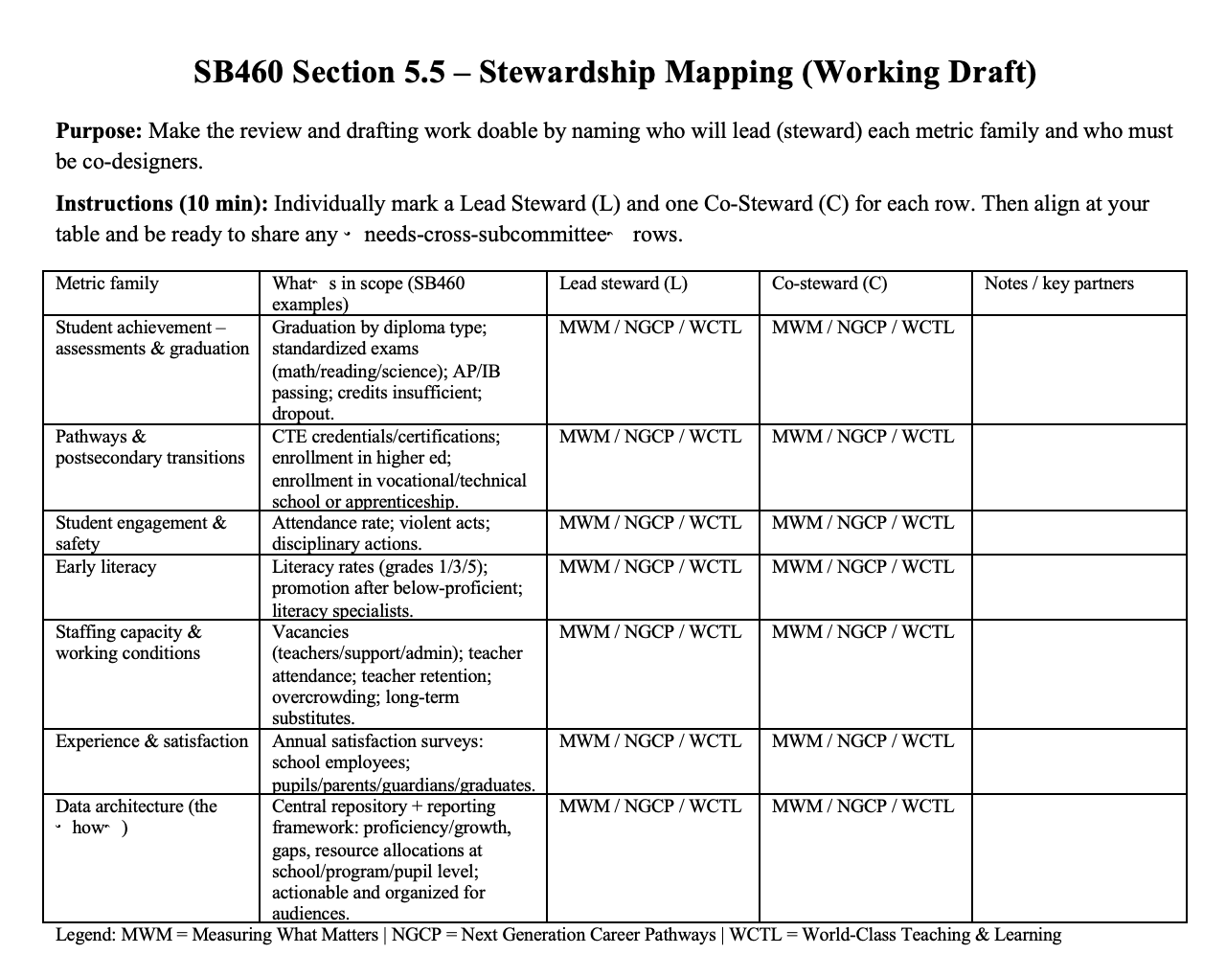
Stewardship Mapping:
Who leads what (and who must co-design)
Individually (8 min):
For each row, mark Lead Steward (L) and Co‑Steward (C)
If you’re unsure, mark “?” and keep moving
At tables (8 min):
Compare answers → align on top 3 rows that require cross-subcommittee co-design
Be ready to share 1 minute/table
Definitions (plain language):
Lead steward: convenes the work + drafts the first pass
Co‑steward: must be involved early; helps set criteria + interpret implications

Slide 69
Stewardship Mapping
Metric family | What’s in scope (SB460 examples) | Lead steward (L) Co-steward (C)
Student achievement – assessments & graduation | Graduation by diploma type; standardized exams (math/reading/science); AP/IB passing; credits insufficient; dropout. | MWM / NGCP / WCTL
Pathways & postsecondary transitions | CTE credentials/certifications; enrollment in higher ed; enrollment in vocational/technical school or apprenticeship. | MWM / NGCP / WCTL
Student engagement & safety | Attendance rate; violent acts; disciplinary actions. | MWM / NGCP / WCTL
Early literacy | Literacy rates (grades 1/3/5); promotion after below-proficient; literacy specialists. | MWM / NGCP / WCTL
Staffing capacity & working conditions | Vacancies (teachers/support/admin); teacher attendance; teacher retention; overcrowding; long-term substitutes. | MWM / NGCP / WCTL
Experience & satisfaction | Annual satisfaction surveys: school employees; pupils/parents/guardians/graduates. | MWM / NGCP / WCTL
Data architecture (the ‘how’) | Central repository + reporting framework: proficiency/growth, gaps, resource allocations at school/program/pupil level; actionable and organized for audiences. | MWM / NGCP / WCTL

Slide 70
Stewardship Mapping:
Debrief
Where did we see clear ownership vs. shared stewardship? Why?
Which metric families will be highest risk if reviewed without domain experts?
What do we need from NDE / Commission on School Funding to avoid parallel systems?
What are the top 3 “needs-clarity” questions we should send to counsel/partners?

Slide 71
Draft Workflow for Discussion
From stewardship to a workable review and drafting process.
1 | Confirm metric intent + review questions | What decision is this metric meant to inform? (If none: why are we reporting it?)
2 | Check availability/quality | What’s the definition + data source + known limitations?
3 | Draft: what we can responsibly say | What disaggregation is essential to identify gaps? What gaps and progress does the existing data show?
4 | Draft recommendations | What would “improvement” plausibly look like over time—and what could create false signals?
5 | Integrate into annual report package and repository | How should it appear in the report and repository so it’s usable (for districts, parents, policymakers, etc.)?

Slide 72
VIII
Synthesis and Next Steps
Notes:
SLIDES 58-60- JANICE
1:30-1:45pm

Slide 73
2025 - 2026 Remaining Arc of the Year
February 26-27
March
April
21-22
May
June 9-10
NGCP: 3/11
WCTL: 3/24
MWM: 3/24
NGCP: 5/11
WCTL: 5/13
MWM: 5/14*
Revisiting the roadmap: revisions, updates, and new recommendations.
DISCUSSION
Planning and Prioritization Our Offers
Follow up on planned actions from February Session
Legitimacy, Endorsement, and Handoffs
Revisiting the roadmap: revisions, updates, and new recommendations.
REVIEW AND APPROVAL
Full Commission
Subcommittee
Meetings
Full Commission
Subcommittee
Meetings
Full Commission

Slide 74






Janice Case
Regional Director West
jcase@ncee.org
Nathan Driskell
Chief Policy Officer
ndriskell@ncee.org
Sophia Roy
Leader in Residence
sroy@ncee.org
Keep your finger on the pulse of education. Follow NCEE on LinkedIn to engage with the latest trends, discussions, and innovations in the field of education.
Notes:
Thank you all for the time and thinking tonight. If additional ideas surface after you’ve had a chance to sit with this, please feel free to reach out to us. Appreciate you, and have a good afternoon.

