Slide 4
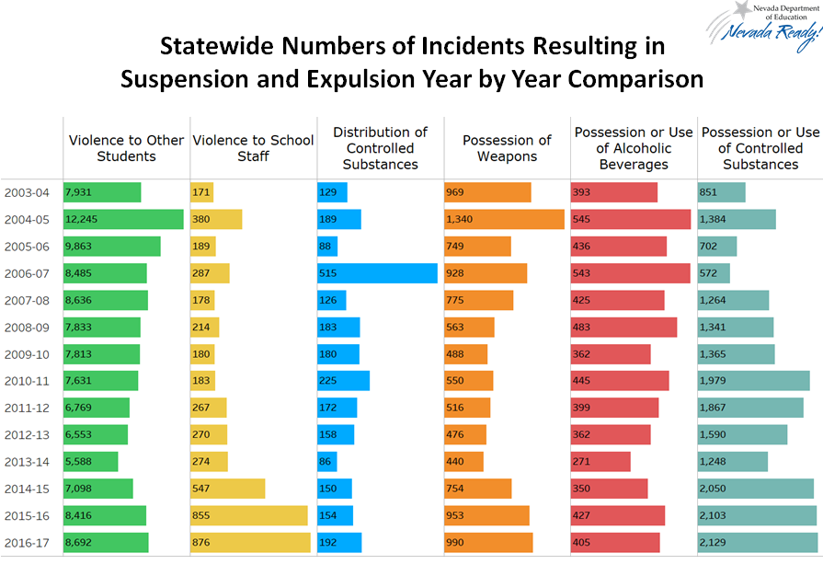

Slide 6
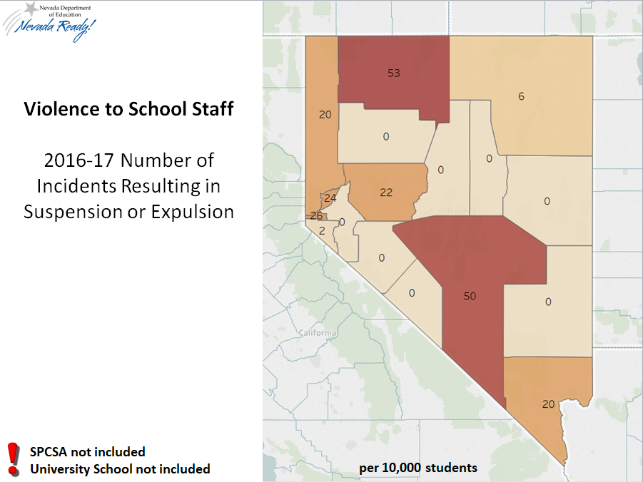
Violence to School Staff
2016-17 Number of Incidents Resulting in Suspension or Expulsion

Slide 7
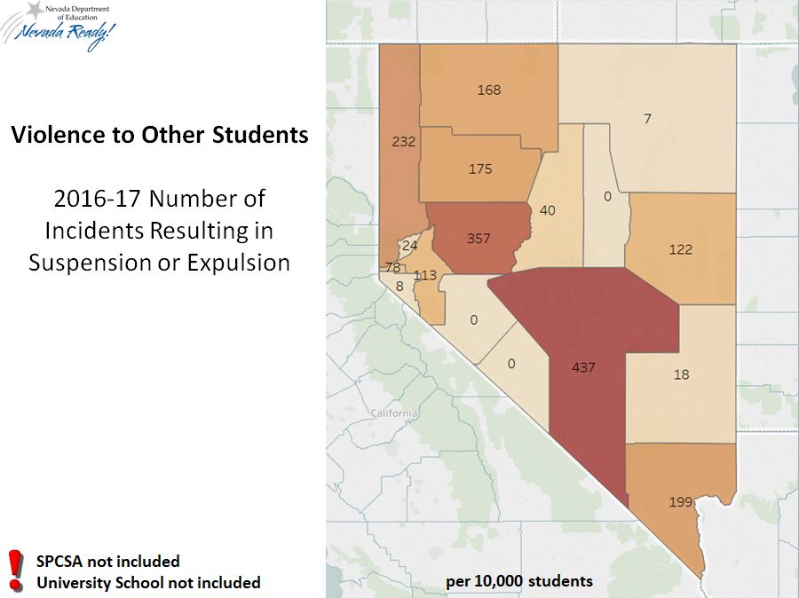
Violence to School Staff
2016-17 Number of Incidents Resulting in Suspension or Expulsion
Violence to School Staff
2016-17 Number of Incidents Resulting in Suspension or Expulsion

Slide 8
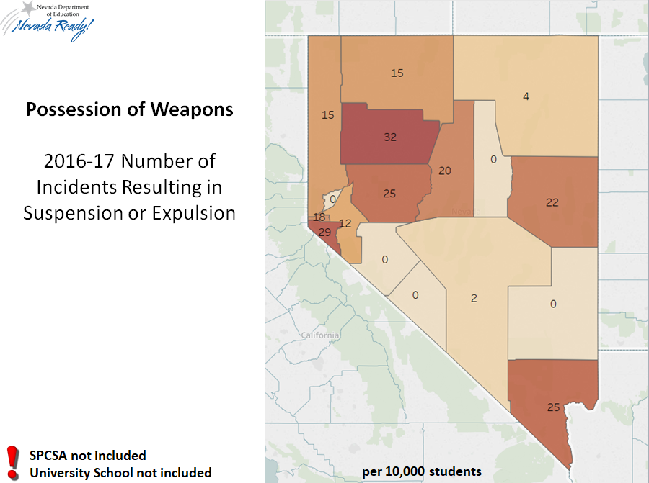
Possession of Weapons 2016-17 Number of Incidents Resulting in Suspension or Expulsion
Possession of Weapons
2016-17 Number of Incidents Resulting in Suspension or Expulsion

Slide 9
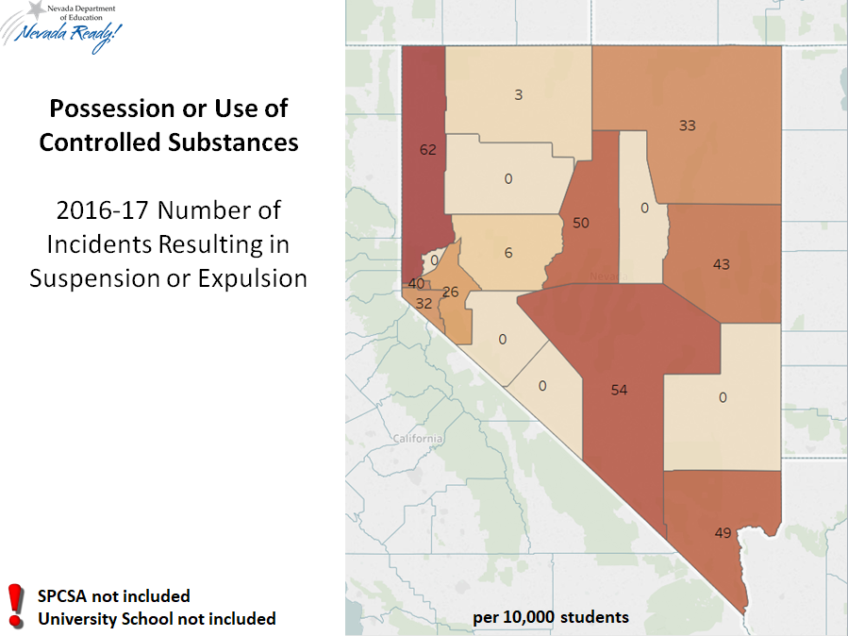
Possession or Use of Controlled Substances
Possession or Use of Controlled Substances

Slide 10
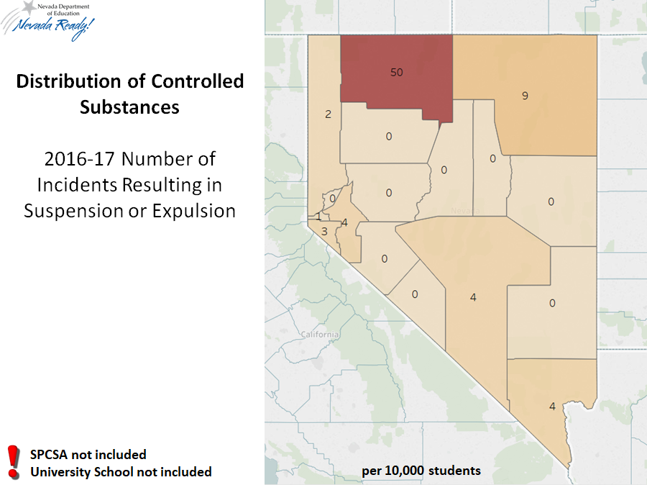
Distribution of Controlled Substances
Distribution of Controlled Substances

Slide 11
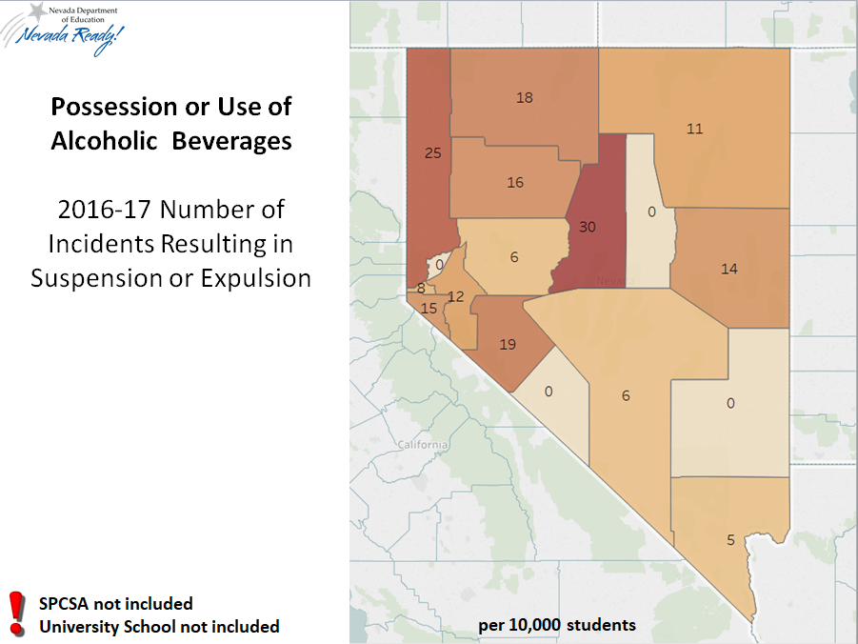
Possession or Use of Alcoholic Beverages
Possession or Use of Alcoholic Beverages

Slide 12
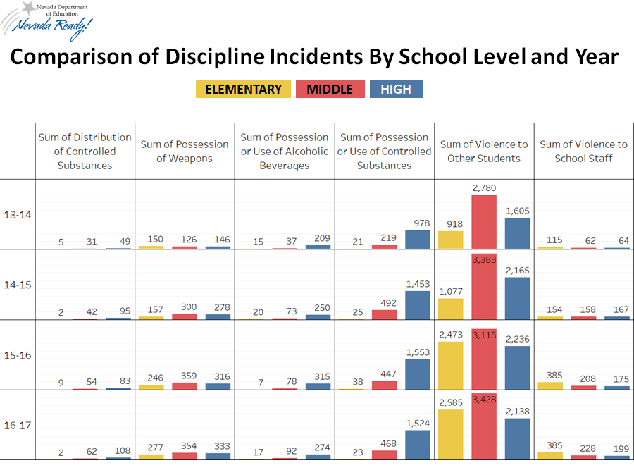

Slide 13
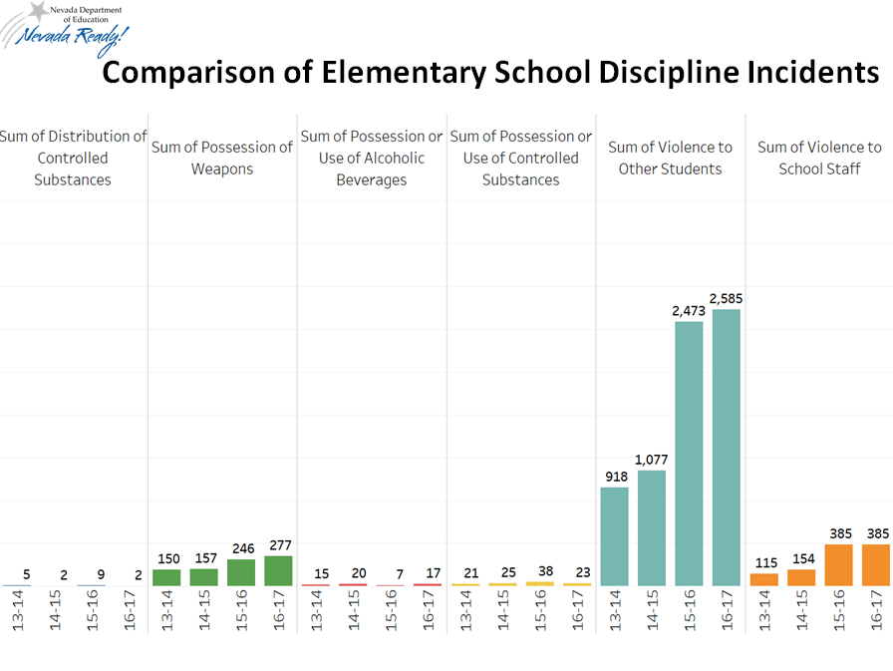

Slide 14
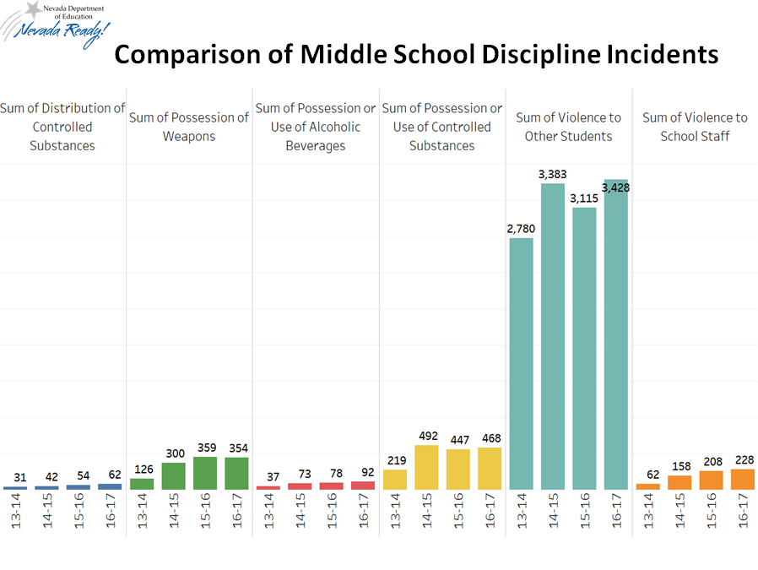

Slide 15
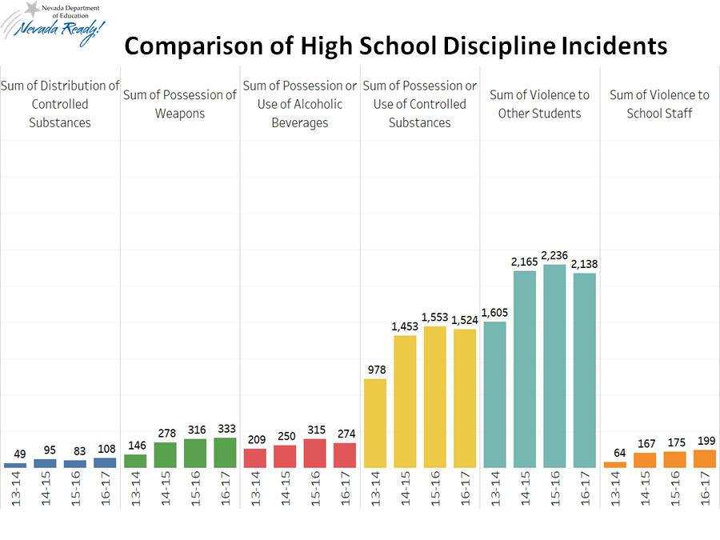

Slide 16
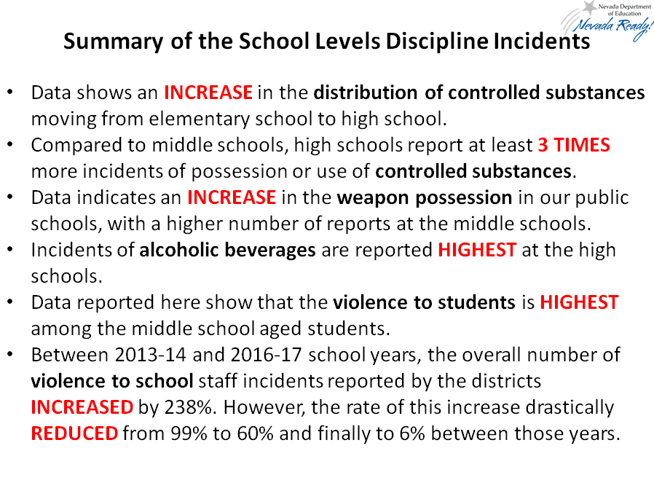

Slide 17
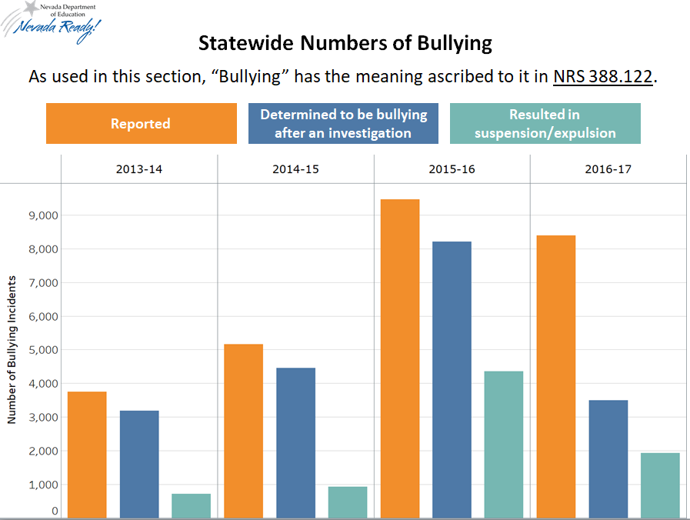
Statewide Numbers of Bullying

Slide 18
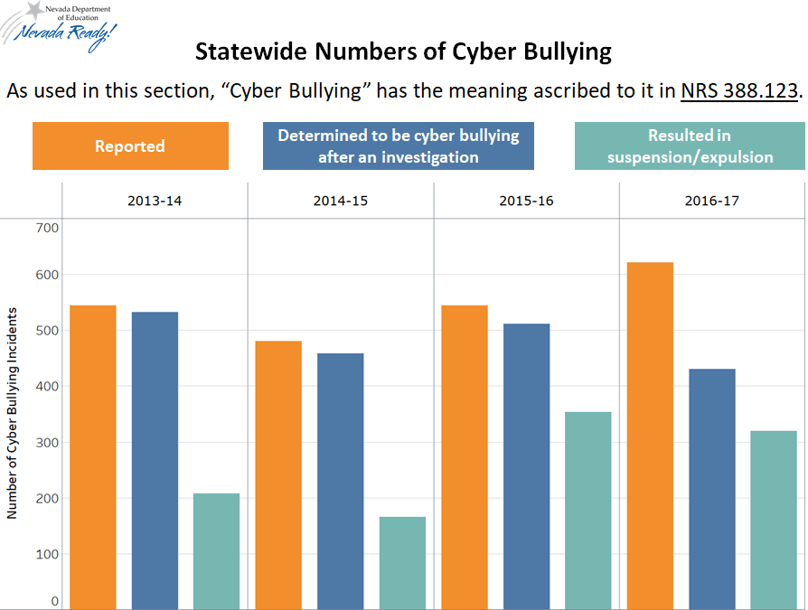
Statewide Numbers of Cyber Bullying

