Slide 1
State Policy Responses to School Violence

Slide 2
Who we are

Slide 3
What we do

Slide 4
Outline

Slide 5
Policy Responses to School Violence

Slide 6
Policy Responses to School Violence.

Slide 7
Policies Governing Weapons in Schools

Slide 8
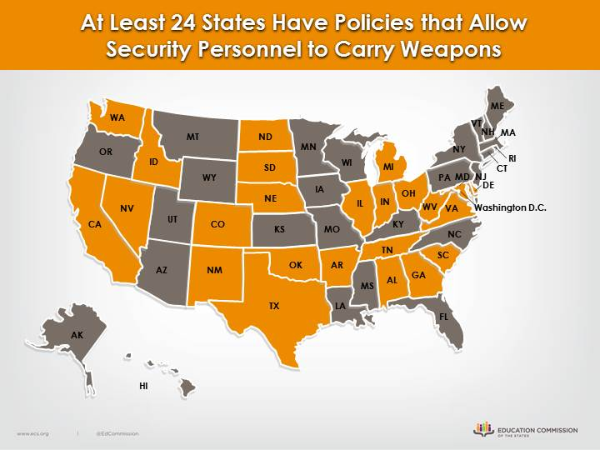
At Least 24 States Have Policies that Allow Security Personnel to Carry Weapons

Slide 9
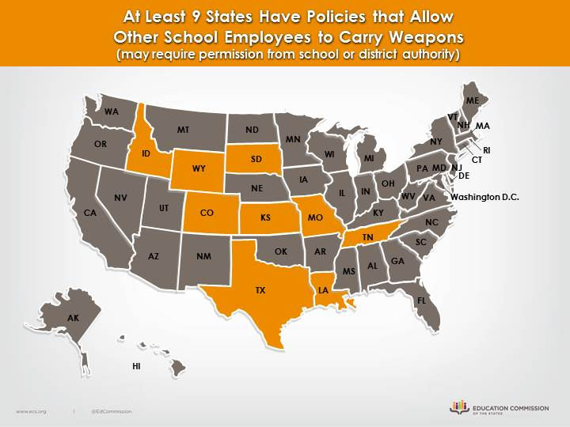
At least 9 State have policies that allow other schools employees to carry weapons ( may require permission from school or district authority)

Slide 10
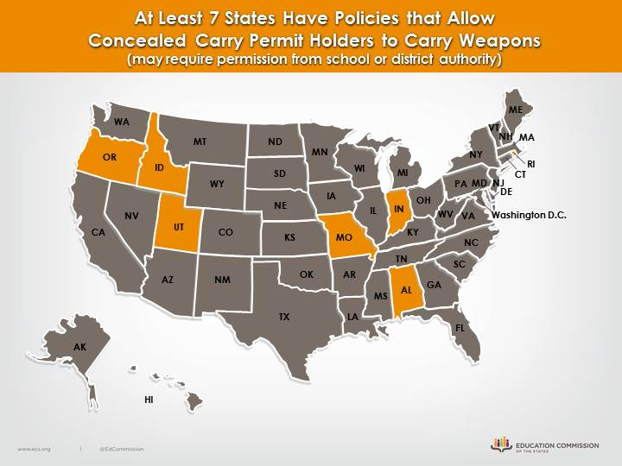
At Least 7 States Have Policies that Allow Concealed Carry Permit Holders to Carry Weapons (may require permission from school or district authority)

Slide 11
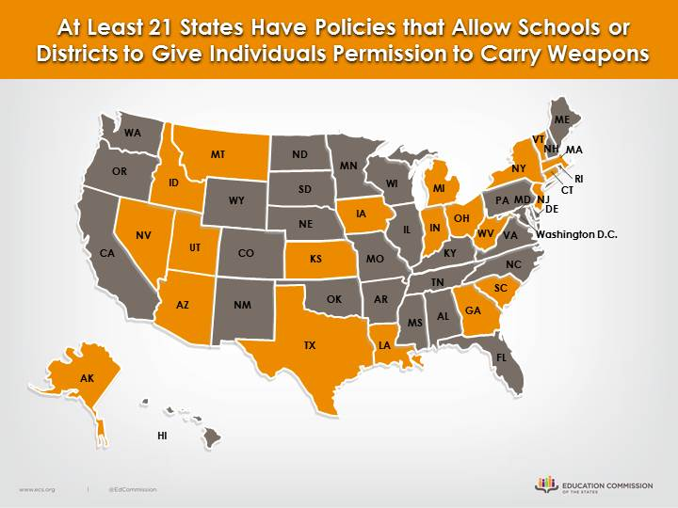
At Least 21 States Have Policies that Allow Schools or Districts to Give Individuals Permission to Carry Weapons

Slide 12
School Resource Officers

Slide 13
School Resource Officers.

Slide 14
School Resource Officers..

Slide 15
Maryland Safe to Learn Act of 2018

Slide 16
Resources

