Slide 1
State of Nevada
SEAL OF
EXCELLENCE
CIVICS
PROVIDING HIGH-QUALITY CIVIC INSTRUCTION & ENGAGEMENT TO NEVADA STUDENTS

Slide 2
SB 194
During the 2021 Legislative Session SB 194 was passed and signed into law.
The bill (as enrolled) outlined the following
The Creation of a State Seal of Civics that can be earned upon High School Graduation
The Creation of a Nevada School of Civic Excellence program
A Student Civic Leader Award
A teacher (or other school employee) Civic Leader Award
SEAL OF
EXCELLENCE
CIVICS

Slide 3
State of Nevada
Citizenship
Citizenship should reflect the student's ability to demonstrate civic knowledge by fulfilling their civic and social responsibilities, through action to positively impact the well-being of the communities to which they belong.
HIGH SCHOOL SEAL OF CIVICS
High Quality Civics Instruction & Engagement
The School, The Classrooms, and School Community uses a consistent foundation of the disciplinary skills in the Social Studies to plan
The entire school community demonstrates civic knowledge by fulfilling their civic and social responsibilities, through action to positively impact the well-being of the communities to which they belong.
Definitions

Slide 4
State of Nevada
HIGH SCHOOL SEAL OF CIVICS
Each grade includes the same set of disciplinary skills that become more complex as students move through their K-12 social studies experience:
•Constructing compelling questions
•Creating supporting questions
•Gathering and evaluating sources
•Developing claims and using evidence
•Communicating and critiquing conclusions
•Taking informed action
NVACS-Disciplinary Skills

Slide 5
State of Nevada
HIGH SCHOOL SEAL OF CIVICS
Requirements for Seal
Student must :
earn at least a 3.25 grade point average on a 4.0 grading scale or, if a different grading scale is used, a 3.85 weighted grade point average on a grading scale approved by the Superintendent of Public Instruction.
Demonstrates proficiency in civics by earning:
At least 3 credits in social studies; (any social studies core class or social studies elective)
A score of at least 90% on the examination for civics required pursuant to NRS 389.009; and (taken no more than 2 times)
A satisfactory score in citizenship (4 semesters in any social studies class with an average of 3.0 and above)
Completes a service learning project.

Slide 6
Citizenship should reflect the student's ability to demonstrate civic knowledge by fulfilling their civic and social responsibilities, through action to positively impact the well-being of the communities to which they belong. | Citizenship should reflect the student's ability to demonstrate civic knowledge by fulfilling their civic and social responsibilities, through action to positively impact the well-being of the communities to which they belong. | Citizenship should reflect the student's ability to demonstrate civic knowledge by fulfilling their civic and social responsibilities, through action to positively impact the well-being of the communities to which they belong. | Citizenship should reflect the student's ability to demonstrate civic knowledge by fulfilling their civic and social responsibilities, through action to positively impact the well-being of the communities to which they belong.
Criteria Statements | 3 | 2 | 1
Mindset | Consistently takes initiative with learning and thinks independently. perseveres, pushes self to be accountable, seeks/accepts feedback. contributes to a positive learning environment. | Often takes initiative with learning and thinks independently. perseveres, pushes self to be accountable and seeks/accepts feedback. contributes to a positive learning environment. | Rarely takes initiative for learning. pushes self to finish task or be accountable. seeks/accepts feedback for improvement. makes the learning environment positive
Active Learning | Consistently listens actively to others and contributes to discussion when appropriate. uses class time wisely and often takes a leadership role in group activities | Often listens actively to others and contributes to discussion when appropriate. uses class time wisely and sometimes takes a leadership role in group activities. | Frequently demonstrates minimal effort and/or occasionally chooses not to engage or participate in class activities. misuses class time and rarely takes leadership role in group activities.
Personal Responsibility | Consistently attends class on time. prepared with required materials and completed assignments to work from the beginning to end of class. is well organized. | Often in attendance and on time for class with required materials and completed assignments. works from the beginning to end of class | Frequently absent or late to class (unexcused). unprepared or without materials and completed assignments. needs to be reminded to stay on-task.
Social Responsibility | Consistently mindful of school rules. respectful and cooperative with staff and classmates. treats school and equipment with care. demonstrates integrity/honesty in learning. a positive, caring, helpful citizen in class. | Often mindful of school rules. respectful and cooperative with staff and classmates. treats school and equipment with care. demonstrates integrity/honesty in learning. a positive, caring, helpful citizen in class | Frequently disregards class/school rules. disrespectful and/or uncooperative with others mistreats school equipment or supplies. has copied or been dishonest with work submitted. a negative citizen in class
State of Nevada
HIGH SCHOOL SEAL OF CIVICS
Citizenship Rubric
Students must earn a satisfactory score on this rubric
*an average of a 2 overall

Slide 7
State of Nevada
Students must complete a service learning project as part of the requirements for the High School Seal of Civics. This can be done independently or as a class project.
HIGH SCHOOL SEAL OF CIVICS
According to Vanderbilt University, service learning is defined as: "A form of experiential education where learning occurs through a cycle of action and reflection as students seek to achieve real objectives for the community and deeper understanding and skills for themselves."
Service Learning Requirement
A unit outline is provided on the next page. If a student completes the SLP independently a district and/or school designee* will supervise the student's project to ensure the steps are followed.
*school designee could be a school counselor, teacher, curriculum adminstrator, etc. It is suggested the designee is at the school level and that one person is the final sign-off on the achievement
Brainstorming
Research
Proposal
Assessment
Reflection
Implementation
Presentation

Slide 8
Service Learning Unit Outline
Identifying Problems: Student(s) brainstorm in writing the ways in which they can help their world or their local community.
Selecting a Problem(s): Students work through selecting the area of service that best suits them personally for individual projects and/or use a democratic process to vote on an area of service that works for the entire class for class projects.
Researching the problem: Guide students in techniques to help them search wisely and efficiently. Students should conduct online polls (crowdsourcing) and create graphs to chart their findings. Students should summarize their findings using embedded images, graphs, and other multimedia elements.
Implementation: Student(s) should proceed to implement a service learning project.
Develop a portfolio to present your research: Students should create a presentation portfolio using the first 4 steps of the project to be presented in an academic setting to an authentic audience.
Presenting your Portfolio to an authentic audience: Students should present their findings to the school, each other, and outside stakeholders in authentic environments. They can develop posters to promote their call to action, write a letter campaign, or develop a simple website.
Assessment: Projects should utilize multiple stakeholders for the assessment process:
Community assessment: Community partners can get their say as well by assessing the students. They may even get a voice in developing the rubric or criteria for evaluating the students.
Teacher assessment: Along with evaluating students on the content, a teacher might additionally assess them on how well they accomplished the writing, graphing, researching, or speaking.
Student assessment: Students conduct self-assessment as a form of reflection. They also may assist in developing the rubric that other stakeholders use to assess them.
Reflection: Students must think back on what they gained from journeying through this project. Reflection might include the following:
What did you learn about the topic?
What did you learn about yourself?
How do you now think differently?
State of Nevada
HIGH SCHOOL SEAL OF CIVICS
Service Learning Requirement
Adapted From: https://www.edutopia.org/blog/what-heck-service-learning-heather-wolpert-gawron & Project Citizen: Community Engagement in Public Policy from the Center for Civic Education

Slide 9
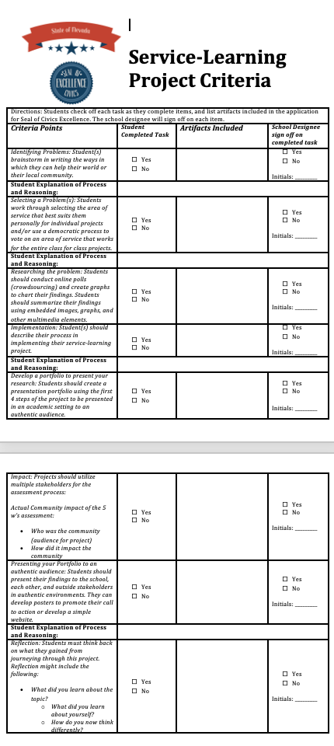
State of Nevada
SEAL OF CIVIC EXCELLENCE
Service Learning Project
Criteria Checklist

Slide 10
State of Nevada
HIGH SCHOOL SEAL OF CIVICS
March 6, 2023
The Nevada State Seal of Civics recognizes students who attain a high level of proficiency in civics learning. The Civics Seal helps Nevada’s high school graduates to communicate their credentials to postsecondary education programs.
A contest to design the official seal opened March 6th, the beginning of the first ever national civics week. Winning images will embody the spirit of the Civics Seal and Nevada-specific attributes. Winners will receive a framed copy of their Seal and a gift card. For more information, including image requirements, or to enter, please email Jmalorni@doe.nv.gov
Art Contest to Design Nevada High School Seal of Civics

