Slide 1
Selected national statistics relevant to school violence and safety

Slide 2
Where are school-aged youth murdered?

Slide 3
Where do school-aged youth commit suicide?

Slide 4
Risk of homicide/suicide at school (2014-2015)

Slide 5
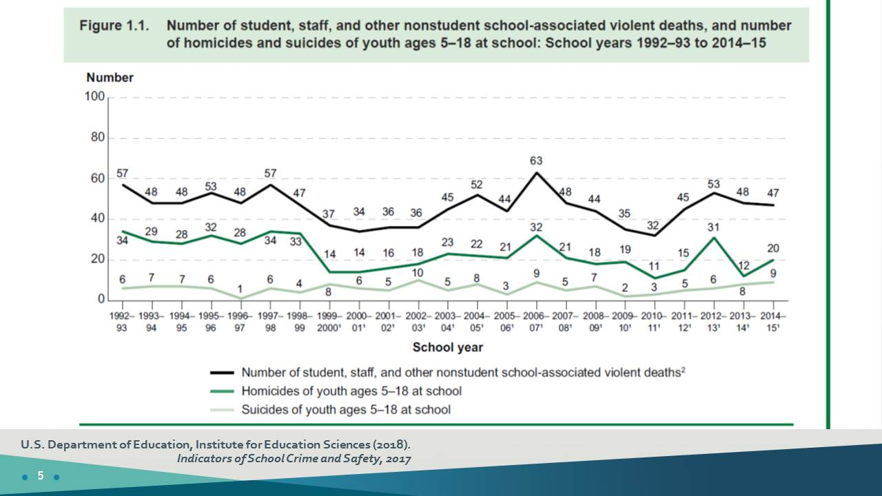
Number of student, staff and other nonstudent school associated violent deaths, and number of homicide and suicides of youth ages 5-18 at school: School yerars 1192-93 to 2014-15

Slide 6
THE CONTINUUM OF SCHOOL VIOLENCE

Slide 7
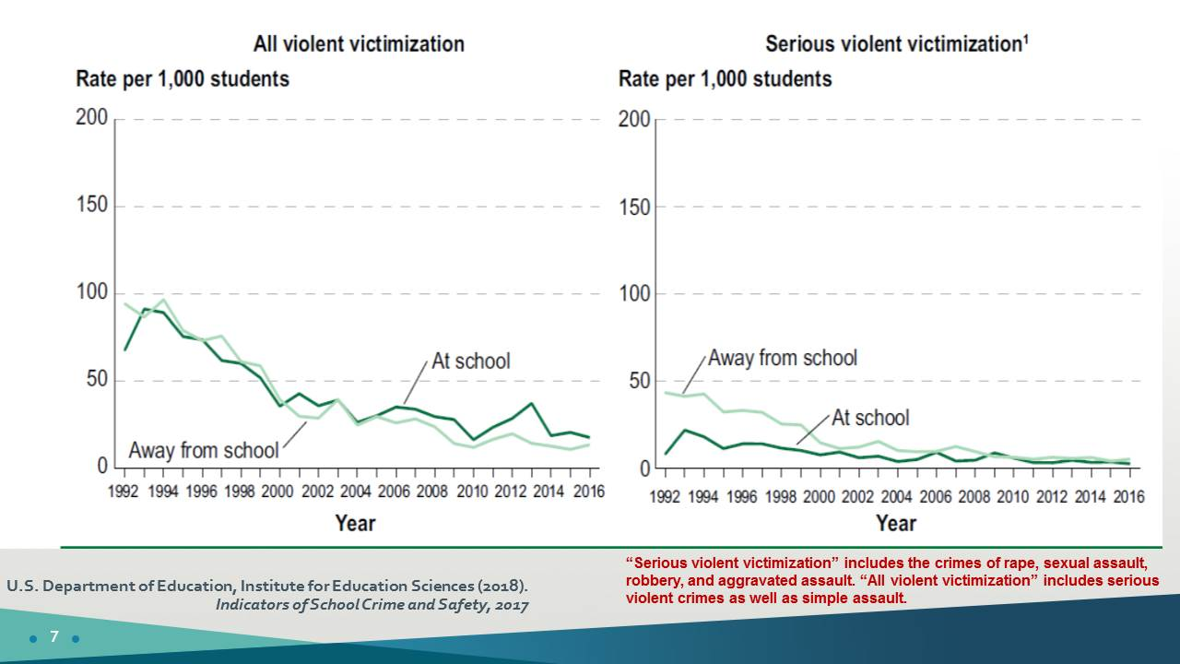
Serious violent victimization” includes the crimes of rape, sexual assault, robbery, and aggravated assault. “All violent victimization” includes serious violent crimes as well as simple assault.

Slide 8
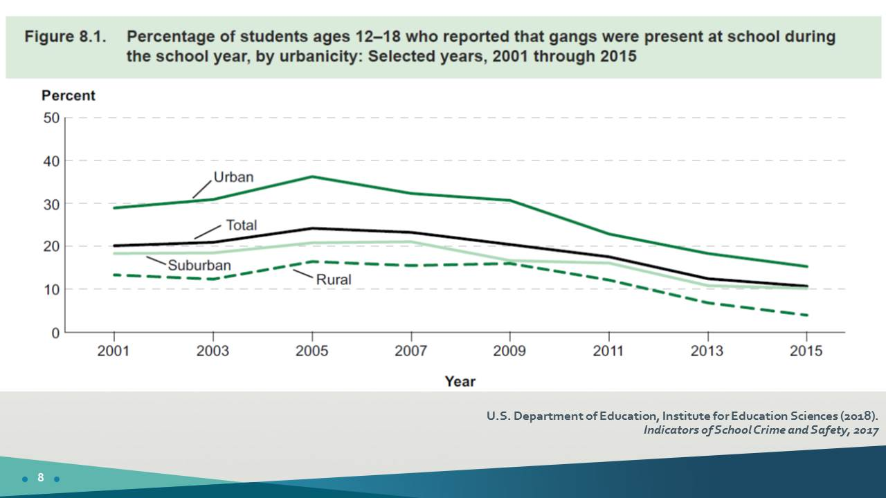
Percentage of students ages 12-18 who report that gangs were present at school during the school year, by urbanity:

Slide 9
Further Data along the School Violence Continuum

Slide 10
Other Violence/Threat Offenses on the Continuum

Slide 11
Percentage of students self-reporting they were bullied during prior 12 months (Two National Surveys)

Slide 12
The role of bullying in school shootings

Slide 13
Bullying trends, 2005-2015, by urbanicity and by sector

Slide 14
Student attacks/threats on teachers

Slide 15
Percentage of students, age 12-18, indicating they were afraid of attack or harm at school

Slide 16
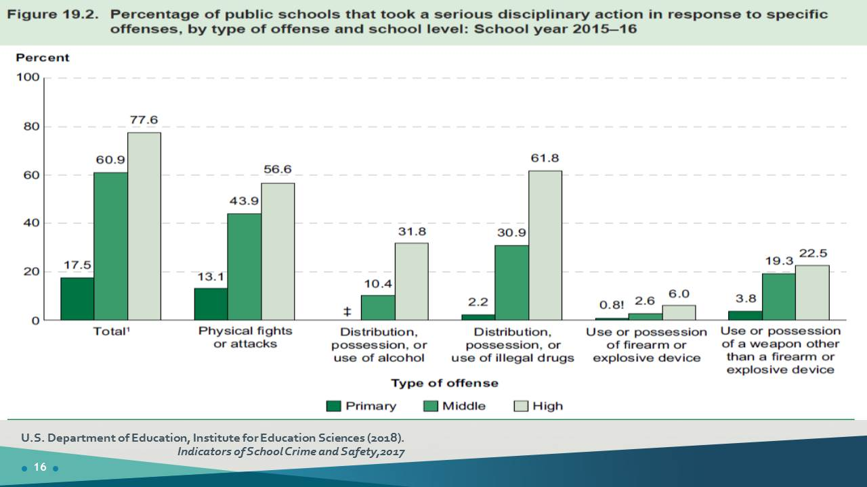
Percentage of public school that took a serious disciplinary action in response to specific offenses by type of offense and school level

Slide 17
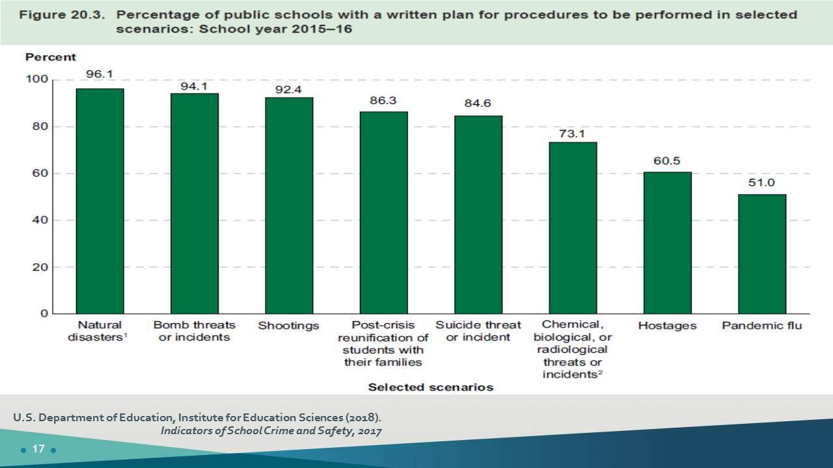
Percentage of public schools with a written plan for procedures to be performed in selected scenarios

Slide 18
Principal Survey Data: Drills

Slide 19
Students (age 12-18): Selected Security Measures at their School

Slide 20
Acknowledgement

